Slide 1
EMAIL SPAM DETECTION
PROJECT BATCH : 6
PROJECT GUIDE
ARETI RACHANA (20KN1A4204)
MANDA HARITHA (20KN1A4234)
MANEPALLI BHANUSRI (20KN1A4235)
THIRUMALA SAI SUNDAR (20KN1A4259)
Mr. RAJESH

Slide 2
contents
01
02
Problem statement
Existing System
Proposed System
03

Slide 3
PROBLEM STATEMENT

Slide 4
Email spam remains a pervasive issue that affects individuals and organizations alike. Users constantly deal with unwanted and potentially harmful emails, exposing them to risks such as scams, malware, and phishing attacks. Existing spam filters, although useful, are far from flawless, often marking legitimate emails as spam (false positives) or failing to catch spam (false negatives).

Slide 5
EXISTING SYSTEM

Slide 6
NAÏVE BAYES CLASSIFIER
The Naive Bayes classifier is a probabilistic classifier that can be used for classification tasks. It is based on Bayes' theorem, which states that the probability of event A occurring given that event B has already occurred is equal to the probability of event B occurring given that event A has already occurred, times the probability of event A occurring, divided by the probability of event B occurring.
Naïve: It is called Naïve because it assumes that the occurrence of a certain feature is independent of the occurrence of other features which gives the same results.
Bayes' theorem is also known as Bayes' Rule or Bayes' law, which is used to determine the probability of a hypothesis with prior knowledge. It depends on the conditional probability.
The formula for Bayes' theorem is given as:

Slide 7
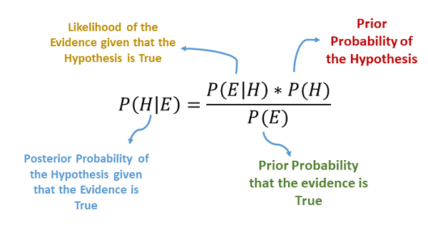
NAÏVE BAYES CLASSIFIER
Posterior Probability : Probability that Email Received is Spam (or) Ham mail by observing features.
Likelihood Probability : Probability of observing particular word. This likelihood estimated from the training data.
Prior Probability : Probability that an email is Spam (or) Ham is based only on frequency of Spam (or) Ham emails in dataset
Evidence(or)Marginal : It is scaling factor used to compute the posterior probability from prior and likelihood

Slide 8
ALGORITHM:
Problem Understanding – Firstly we need to Understand the given problem
Data Collection – After Understanding the problem collect the data related for that problem to resolving it.
Data Cleaning – This Step delete/remove unwanted data (or) unwanted features which are irrelevant to the data.
Feature Selection – We have to select the features which helps to detect and solve the problem
Building a Model – This step consists of selecting the right model. There are many models which can be used for many different purposes. Once the model is selected, it needs to meet the goal.
Evaluating the model – Evaluating the model means to calculate the Accuracy of the algorithm. The output of the accuracy is in between 0 to 1
Make Classifications – If the accuracy of a model is good then start make classifications.

Slide 9
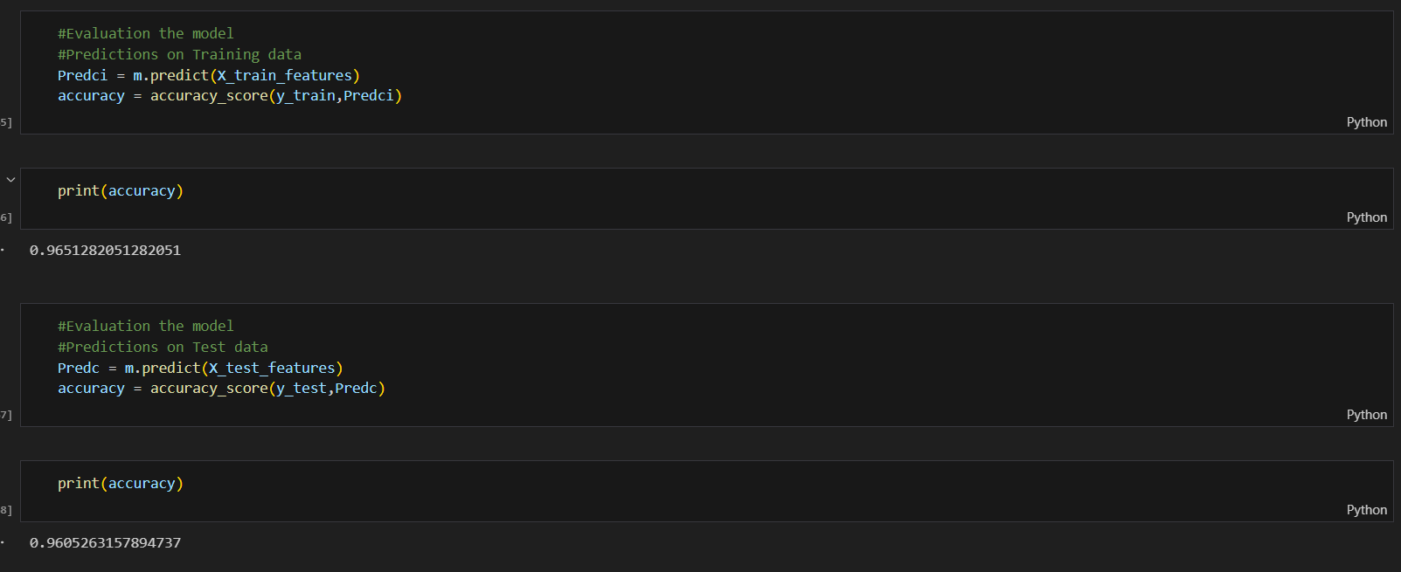
OUTPUT:

Slide 10
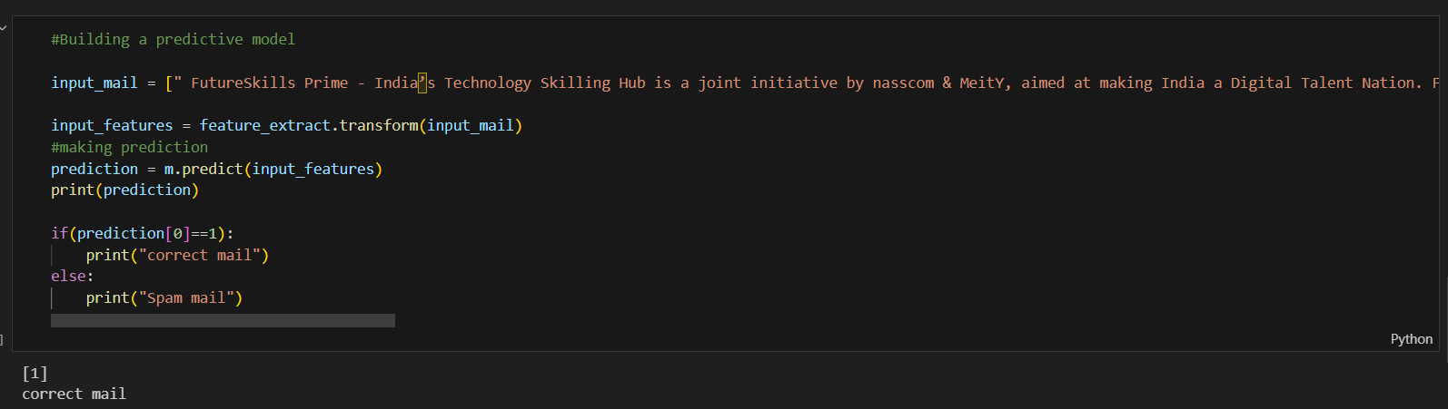
OUTPUT:

Slide 11
DRAW BACKS:
Assumption of Independence
Limited Representation of Relationships
Sensitive to Unseen Data
Difficulty Handling Continuous Data
Sensitive to Text PreProcessing
Inability to Handle Context

Slide 12
Proposed System

Slide 13
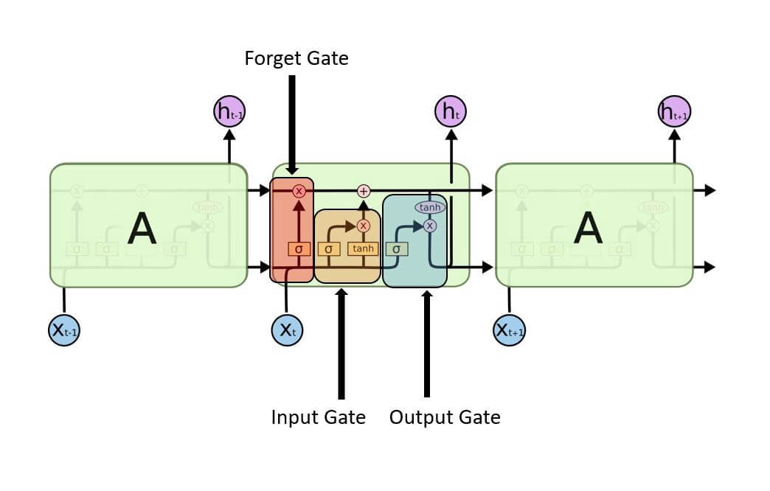
LSTM – LONG SHORT TERM MEMORY
LSTM (Long Short-Term Memory) is a recurrent neural network (RNN) architecture widely used in Deep Learning. It excels at capturing long-term dependencies, making it ideal for sequence prediction tasks.
Unlike traditional neural networks, LSTM incorporates feed-back connections, allowing it to process entire sequences of data, not just individual data points. This makes it highly effective in understanding and predicting patterns in sequential data like time series, text, and speech.

Slide 14



The cells store information, whereas the gates manipulate memory. There are three entrances:
Input Gate: It determines which of the input values should be used to change the memory. The sigmoid function determines whether to allow 0 or 1 values through. And the tanh function assigns weight to the data provided, determining their importance on a scale of -1 to 1.
Forgot Gate: It finds the details that should be removed from the block. It is decided by a sigmoid function. For each number in the cell state Ct-1, it looks at the preceding state (ht-1) and the content input (Xt) and produces a number between 0 (omit this) and 1 (keep this).
Output Gate: The block’s input and memory are used to determine the output. The sigmoid function determines whether to allow 0 or 1 values through. And the tanh function determines which values are allowed to pass through 0, 1. And the tanh function assigns weight to the values provided, determining their relevance on a scale of -1 to 1 and multiplying it with the sigmoid output.

Slide 15
ALGORITHM:
Feature Scaling (Preprocessing of Data):
Feature scaling involves bringing all feature values to a similar scale. In the context of LSTM models, this step is crucial to ensure that the input features are on a similar scale(scaling values to a range of 0 to 1).
Split the Dataset for Train and Test:
The dataset is typically split into two parts: a training set and a testing set. The training set is used to train the model, while the testing set is used to evaluate the model's performance on unseen data.
Converting Features into NumPy Array and Reshaping:
Each sample in the dataset may have multiple features. The data needs to be reshaped into a 3D array (samples, time steps, features) suitable for LSTM
Build the Architecture for the LSTM Network:
This involves deciding the number of LSTM layers, the number of neurons in each layer, activation functions, dropout layers for regularization, and defining input and output layers.
Compile and Fit the Model (Training):
Compile the LSTM model by defining the loss function, optimization algorithm, and metrics to be used to evaluate the model.
Evaluate the Performance of the Model (Test):
Finally, the trained model is tested on the unseen test dataset. Metrics such as accuracy, mean squared error (MSE), or others relevant to the problem domain are calculated to assess how well the model performs on new, unseen data.

Slide 16
THANK YOU

